Slide 1
Leads and cardings the way I play

Slide 2
Leads from honors ag NT, what information do you need?
Attitude?
Count?
Unblock?
Can you solve all this?
NO! You must give up something
What information does your partner need?
If it’s an honor, what does it show or deny?

Slide 3
Some use:
Ace ask for attitude
King ask for count or unblock
I don’t!
Because then you must lead the Queen from
both KQ9xx and from QJ9xx and your partner
will not know if he should encourage holding the 10
or if he must hold the Jack. He may also think declarer
has AK in the suit.

Slide 4
Cardings. UDCA
Means: Count. High-low = odd number, low-high = even number
Low card = encouraging, high card = discouraging.
Advantages attitude:
You never risk losing a trick when you encourage with a small card.
If you hold K1042, P leads the Q and dummy has xx, it´s easy for P to
Read the 2 as encouraging.
If you play ”Standard” you can’t afford the 10 and the 4 is hard to read.
If you play odd/even sometimes you won’t have an odd card to encourage with.
Advantages of UDCA count:
If you play ”standard” and hold 10x you can’t afford to play the 10 to show even number,
It could cost a trick. UDCA eliminates this

Slide 5
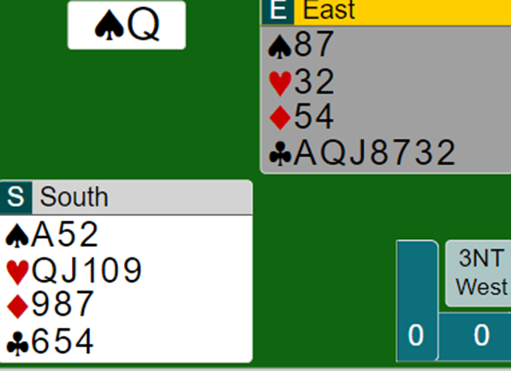
If the lead is from KQ9xx you should just
encourage and you will get 5 quick tricks.
If the lead is from QJ108, your best chance
Is perhaps to win the ace and return the ♥Q
Your guess…

Slide 6
I don’t use the ”asking for count”, only attitude.
If you hold
AKJxx it would be nice to know if you could drop
Qx in declarers hand.
If you lead the King asking for count/unblock it could
work if dummy has xxx and P gives count with the 10.
But if dummy has x and your P unblocks his Q from Qxx
declarer suddenly has a stopper.
If I hold AKJ10x in a suit I will lead the K, and if P holds
the Q, he will know I want an unblock

Slide 7
I lead like this both ag NT and suit
AKxx
KQxx
QJ9x
AJ10xx P will know I have 109x or 2 higher
KJ10xx
K109x P will know it’s the top or 2 higher
J109x P will know it’s the top ( or AQJxx ag NT )
1097x

Slide 8
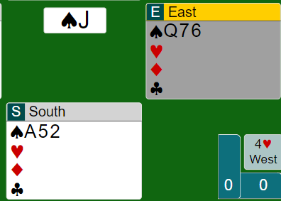
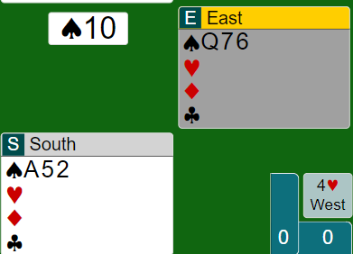
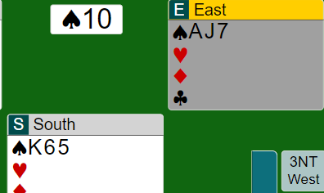
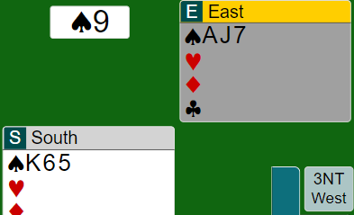
Declarer has the King.
P prob has KJ10 or 109x.
Declarer has the Queen
P has Q109, or 98x

Slide 9
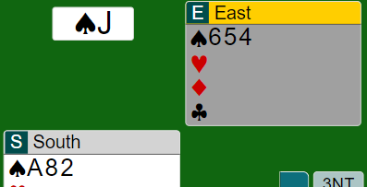
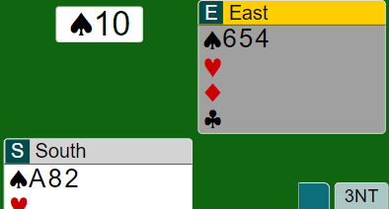
You know decl holds KQ
You know P holds KJ10x.
Sometimes 1098x

Slide 10
Leads ag NT from long suit.
4th best and attitude.
High spot card from weak suit, 4th from good suit
108743
9765
987
K932
AJ632

Slide 11
Leads ag suit: 1-3-5
From honors you lead the same as ag NT.
From length you lead 3rd or 5th.
Count is crucial. You also do that in Partners suit.
K7542
J983
9832
987
1093 This is the only exception. P must be aware.

Slide 12
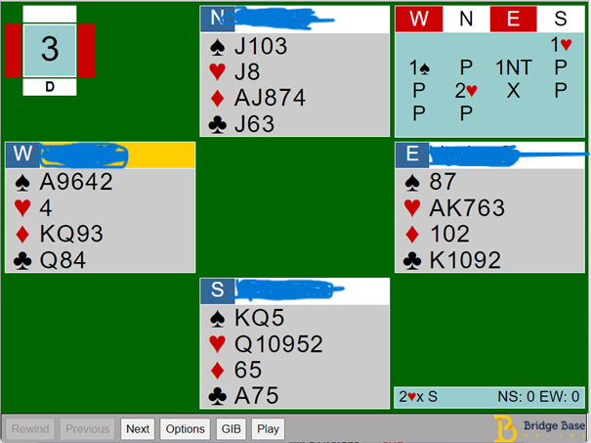
This looks like an easy -2 after the
D king lead.
1S+1ruff, +2H+1D+2C tricks = 7.
This is what happend:
Decl won A ace and played a H to Easts
King. ♠ 8, K, A and another spade to
Souths Queen. Another H to easts K
And a Diamond back.
Now W was uncertain if E could ruff
a spade or if decl would discard.
It ended with an overtrick.
This is why it´s very important to
Play 1-3-5 in Partners suit.
Then West would have known!

Slide 13
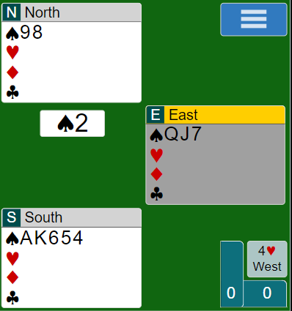
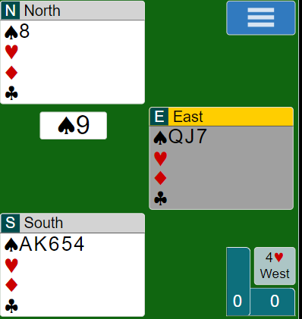
You know P has 3 or singleton,
So no ruff
Now you know P will ruff. Win
A+K if you want a D return.
K+A is just no message

Slide 14
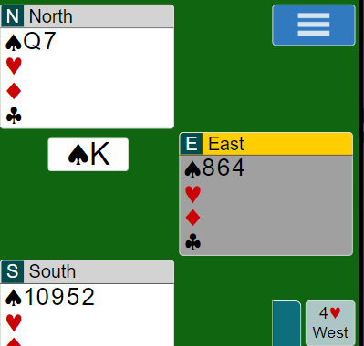
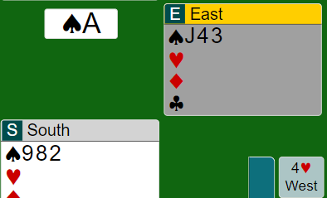
Cardings: UDCA
Priority: Attitude, Count, ( Suit Pref )
Counting should always refer to original number.
Discourage with the 9, later play the 8 to
Show original odd number
Discourage with the 10, later play the 2
to show original even number

Slide 15
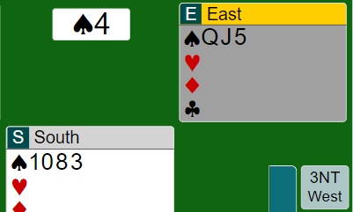
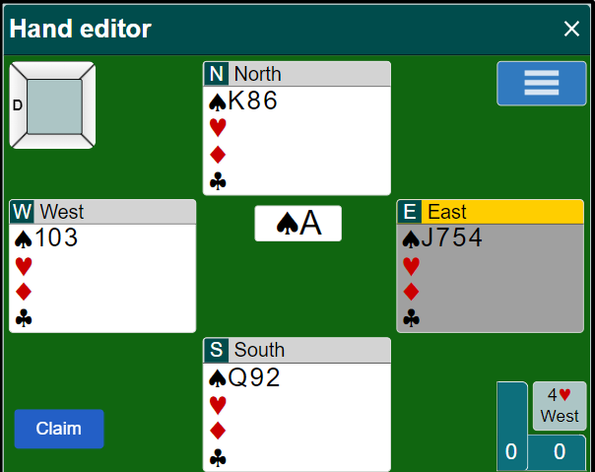
Dummy plays the Q. When you can´t cover, give count with the 10 ( odd nr ).
If you play the 8, you deny 1083!
Do not encourage with the 2! P will think you can ruff the 3rd
round

Slide 16
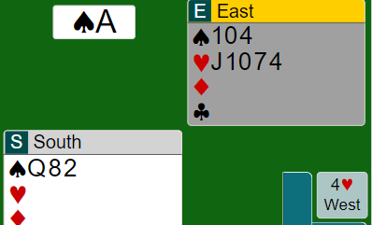
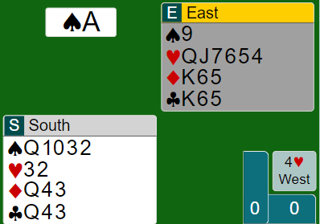
Do not encourage. P may tink you only have xx and are able to overruff dummy. Only encourage if P has overcalled S and you have supported him.
West opened 1NT. This illustrates why I dont play suit pref when dummy has a spl. I have no clue what suit to recommend. I simply encourage S so P will know I have the Queen. Perhaps another spade is the proper defense.

Slide 17
Count or suit pref?
I strongly recommend count because when there are 3 cards left I want to know what to keep.
If you play S/P you must have an agreement with
Your P about which card is neutral and doesn’t give S/P
Decl. runs a suit and you hold 872. You start with the 8 to give count.
Then you can choose between 7 and 2 and there are 2 suits left.
You can´t say: ”The 7 is S/P for the higher suit and the 2 is S/P for the lower.”
Perhaps you can´t recommend any suit!
I play the 7 as ”neutral, no message” but the 2 sends a message.
Same idea if P leads an ace and dummy has a spl. My priority is to
give attitude in P:s suit because I might have nothing to recommend, or
equal values in the other suits. Now P at least know something

Slide 18
Expert corner
I try to combine count and attitude. If I have promised or indicated 5-c in a suit
and P leads the Ace or an honor, I encourage with the second lowest from 5.
So if I open 1H and P leads the ace ag a 4sp contract and I encourage with the 2,
P will know I have 6-c, so perhaps he must shift
Odd/even
When I have showed a long suit 5+, and P leads the Ace and my suit is weak,
I discourage with a high odd card to indicate S/P for the higher suit. A high
even card is for the lower suit. A middle card sends no message.
If I have shown a 6-c suit and P leads x and dummy holds xxx, I win the ace from
AQJxxx. Now decl holds K10x so I cant play a small card. O/E applies.
The Q is for the lower suit ( high even card ) and the Jack for the higher ( high odd card )

Slide 19
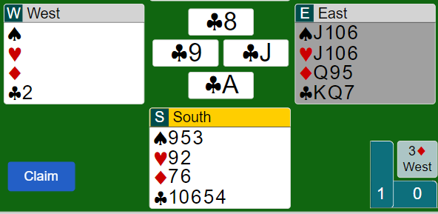
2nd/4th through declarer
I recommend 2/4 with built-in attitude through declarer in unbid suit.
It gives you more flexibility and solves this problem:
If you play ”attitude” and return a 9 in a M,
P will not know if you have a ruff.
If you play 2/4 you return the H2 and now
P will know.
If you have a weak suit return the 2nd,
with a good suit return the 4th.
You can always choose the card that
helps partner. From K103, return the 10.
P will know you have a higher card.

Slide 20
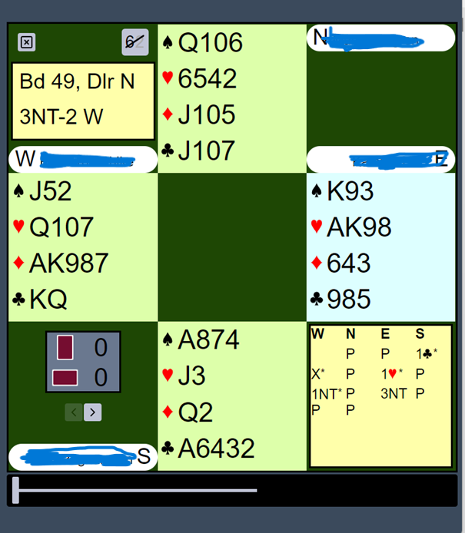
This hand was played in the Festival Teams
The lead was mostly ♣ J and only one pair
did score -2. The rest made it. At the table
who defeated it, decl played a small D in
trick 2. N played the Jack but south
overtook it and played the A of C and a high
club ( spade entry ). If decl plays 3 rounds
of D North will be on lead and now?
They all returned the 10 of C. Curtain!
At every table S encouraged with the ♣2.
An expert would encourage with the 3.
Then N would realize the danger of KQ
bare in W hand, and thus return a small
club. If S held the K he must not play it.
When S played the ♣2 in trick one, it
promises a 4-c suit and then its ok to return the
♣10

Slide 21
If you want to be an expert:
Start counting everything!
Start at trick 1!
Points in each hand
Number of cards in every suit in every hand.
Dummy is the easiest hand ☺
Good Luck!

